Slide 1
Visualizing Iowan Liquor Consumption 2014-2017: with a focus on the 2016 election
Joel Tansey, Joe Chang, Brayden Paur, Gretchen Kuck, Kierstin Ekstrom
Notes:
Kierstin

Slide 2
Literature
Alcohol consumption can be:
Influenced by ancestral consumption, urbanization, and political affiliation (Hart 2019)
Increasing by
demographics:
Youth, male, white, unmarried, smoking, higher education and income (Moore 2005)
More liberal ideology (Yakolev 2013; Musse 2020)
Notes:
Kierstin

Slide 3
Dataset Primary
Liquor consumption January 1st, 2014 to October 1st, 2017
12.5 million observations
Auxiliary
County population
Voting Data- number of votes cast by county
Notes:
Gretchen
Only liquor- no beer or wine
Only at home consumption
12.5 million observations

Slide 4
Larger populations tend to have a Democratic majority
38% of the population live in the 6 majority Democratic counties
Notes:
We see that larger populations tend to have a democratic majority
This will be an issue when looking at liquor sales because larger populations will almost certainly have higher liquor consumption because there are more people.
The way forward: try and do per capita consumption. If we don't democratic majority counties will look like they drink A LOT
Joel

Slide 5
More Democratic Counties
Story
Polk
Blackhawk
Linn
Johnson
Notes:
0/1 of whether the county has more republican or democratic
Which cities have which universities
Joel

Slide 6
Notes:
More expensive alcohol on peaks- maybe it gets more expensive
Brayden

Slide 7
Correlation between Republican and Democrat counties: .92
Democratic counties hold 38% of the population
Notes:
Brayden

Slide 8
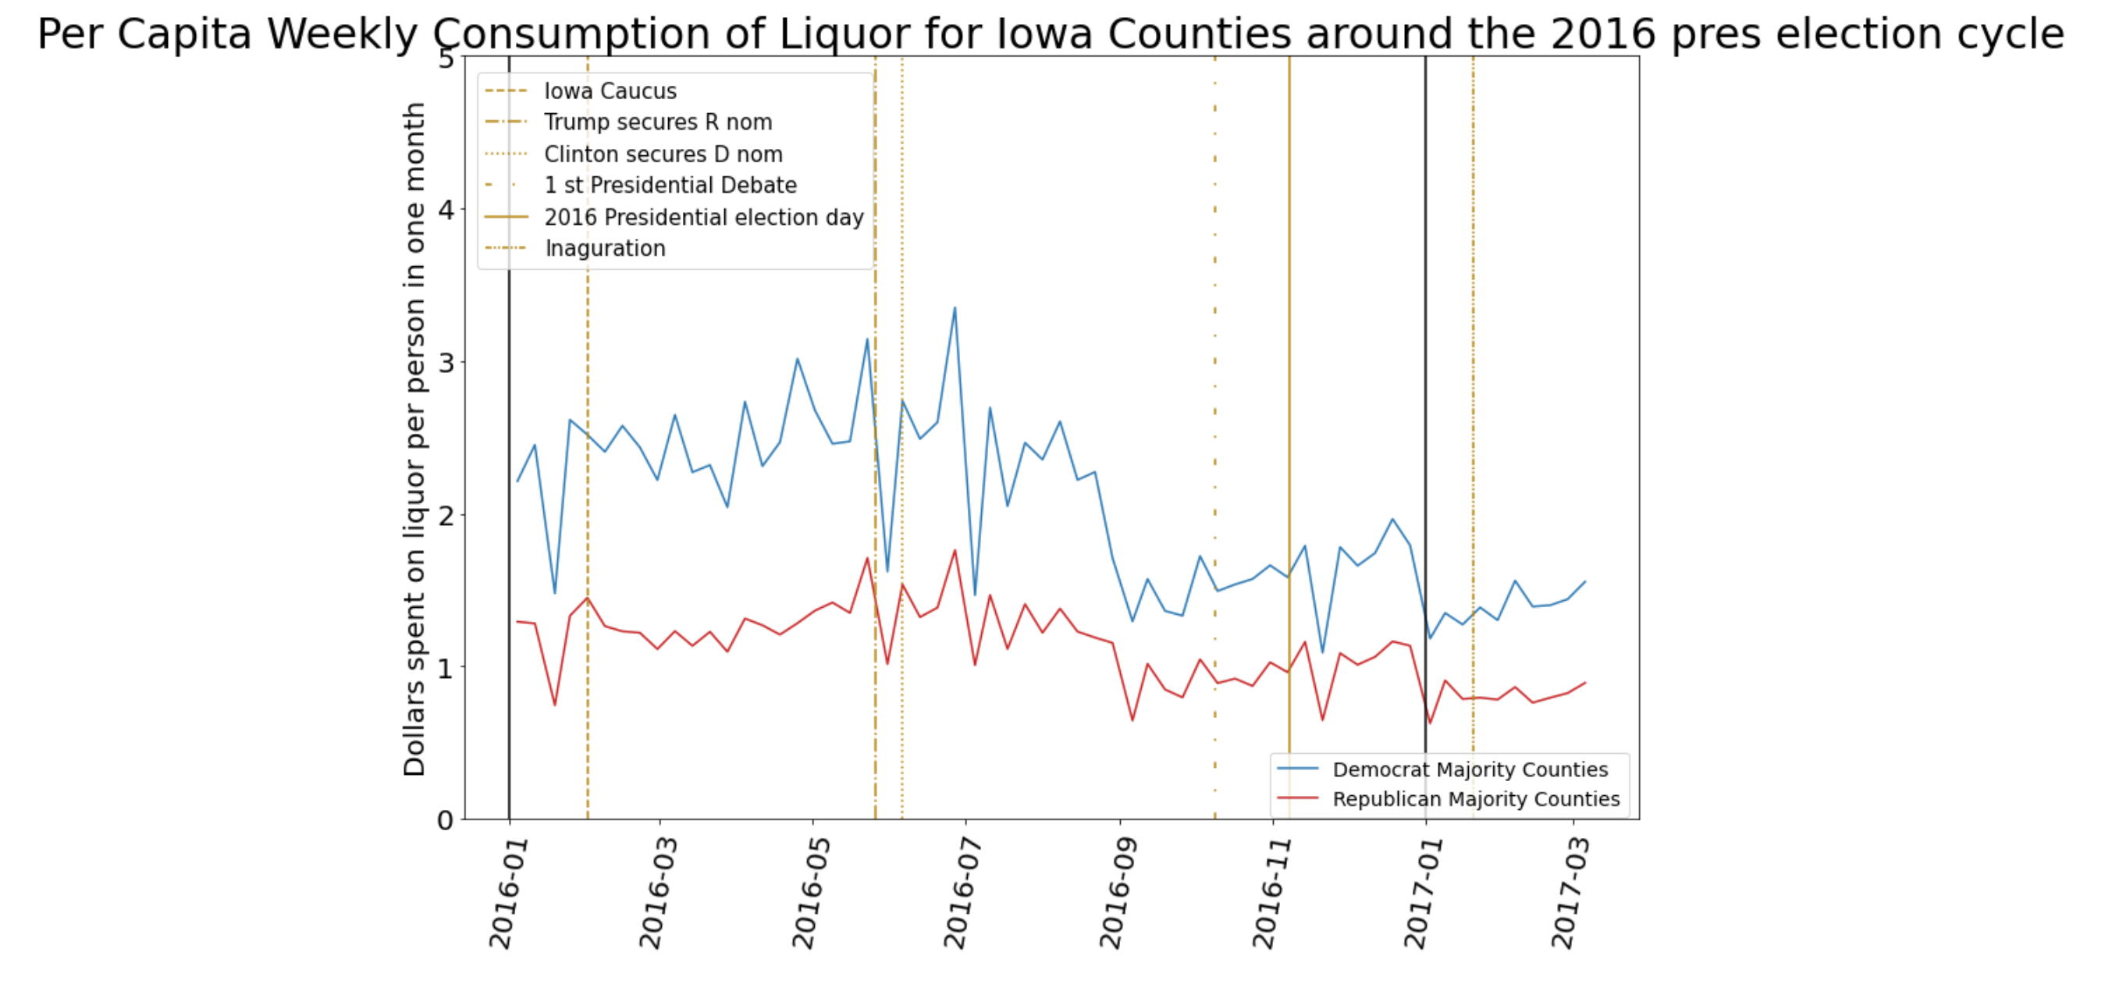
Notes:
Kierstin

Slide 9
Possible Confounding Factors
Iowa state fair- Des Moines- 11 Days in August
Old Thresher’s Festival- September
Football session- starting in August
Less students: June-August
Other types of alcohol consumption
Notes:
Kierstin
Only have store bought liquor- no beer or wine

Slide 10
Conclusion
Our work presents preliminary findings as to how one type of alcohol consumption correlates between Republican and Democratic counties in Iowa over time
We present data visualizations that compare alcohol sales between these political parties over a 3-year period, and depicts how per-capita consumption react to notable events in Iowa during the 2016 presidential election cycle
We find that Republican and Democratic counties hold similar magnitudes of consumption
However, Democratic counties comprise of a smaller fraction of total population in Iowa, and thus have a larger per-capita value than Republican counties
There are several improvements that can be made to make our work more robust:
Analyze results at finer temporal resolution (daily)
Obtain data that was missing from the original dataset
Include data from all types of alcohol consumption so we can draw a broad conclusion about the relationship between alcohol sales and political party affiliation
Notes:
Joe

